Slide 1

EMBEDDED SOFTWARE OF THE INTERNET OF THINGS A.A. 2022/2023
AUTOMATIC IRRIGATION SYSTEM
Roberto Giordano, Pietro Bellini, Francesco La Rosa

Slide 2

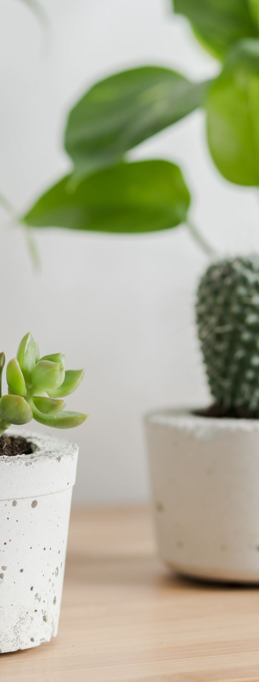
Your garden has never been so easy to manage and admire.
Our system offers a simple and automated way to take care of plants.
It allows to track watering needs even when you're away from home.
Our system alerts you when it's time to water the plants.
Allows to enjoy the beauty and benefits of having plants in the home without any hassle.
It makes taking care of plants effortless and stress-free.

Slide 3
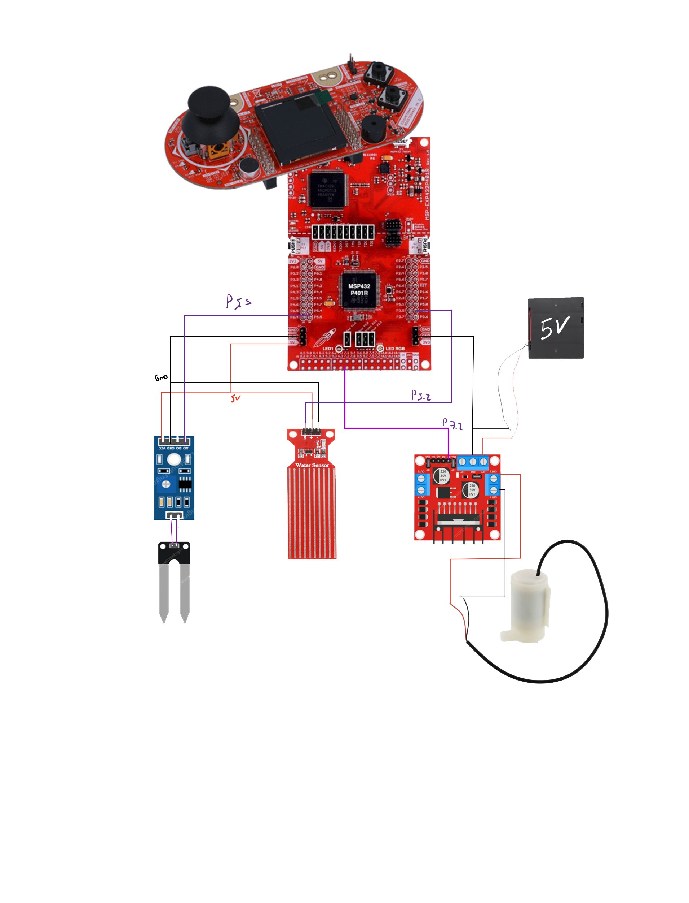
Simplifying Plant Care: A Basic Working Scheme
The system is designed to use the MSP432 microcontroller as the main controller, which reads the data from the sensors for humidity, temperature and uses this information to determine when to activate the water pump and provide water to the plants. The water pump is powered by a 5V power source and is designed to provide the correct amount of water to the plants based on the environmental conditions.
The water sensor is used to monitor the water level and prevent leaks by shutting off the water pump if the water level is too low. This is an important feature to prevent water waste and to ensure that the plants always have enough water.
The user interacts with the system through a user-friendly interface, which allows them to monitor the environmental conditions, control the water pump, and customize the humidity levels to prevent water waste. The interface can be accessed through a computer or a smartphone, and it gives the user full control over the irrigation process.

Slide 4

Software architecture
Sensor data acquisition
This block is responsible for reading data from the sensors for humidity, temperature and water level. The sensors are interfaced with the microcontroller through the pins and the data is read at regular intervals to ensure accurate monitoring of the environmental conditions.
Data interpretation and processing
This block is responsible for interpreting and processing the sensor data to determine when to activate the water pump. The data is analysed using appropriate algorithms and data structures such as if-else statements and conditional statements, and the system is programmed to activate the water pump only when the humidity is below certain threshold values or when is manually activated with the use of the menu and buttons.
Interrupt service routine (ISR)
User interface
Fast timer handler: Each 0.25 sec enables the conversion of ADC14 to sample sensors and converts into a digital value. Moreover, check always the state of water and the level of humidity related to the threshold.
Slow timer handler: Each 1 sec refresh the page on the display showing new data. Moreover is used to switch from to the welcome state to the start state.
Port 3-4-5 handler: Fire when one of the three buttons configured are pressed.
ADC14 handler: Activated from the fast timer, sample and converts the value of the sensors and store it in global volatile variables.
The user interface is designed to be easy to use and allows the user to monitor the environmental conditions, control the water pump and customize the humidity levels.
Two display contexts are set: the first for the background, the second to underline the highlight the menu choice.
The LCD 128x128 of the boosterpack is used to interact.

Slide 5

Testing
Unit testing: This involves testing individual functions and modules of the code to ensure that they are working correctly. This has be done by creating test cases and comparing the output of the function to the expected output.
Integration testing: This involves testing the system as a whole, including all of its components and interfaces. This has be done by connecting the microcontroller to the sensors, water pump, and user interface and running the code to ensure that everything is working together correctly.
User acceptance testing: This involves testing the system with real users to ensure that it is easy to use and meets their needs. This has be done by getting feedback from users on the user interface, sensor data, and overall functionality of the system.
ISSUES
During the testing process, we encountered several problems such as bugs in the code, issues with sensor data accuracy, and difficulty in connecting the system to the user interface. These problems were solved by thoroughly reviewing the code, troubleshooting the sensor connections, and implementing solutions such as code refactoring and updating the library.
Additionally, we also used debug features such as serial monitor, breakpoints, and watch variables to detect errors and bugs, and then we solved these issues with the right approach.
In the end, we made sure that the system passed all the test cases and that it met the requirements and expectations of the users.

Slide 6
Upgrades
Working WiFi connection with eventual Telegram Bot:
Water limit removal (e.g. attachment to tap water):
Multiple plant management:
Other uses:
Agriculture:
This upgrade would allow the user to remotely control and monitor their irrigation system through a Telegram Bot. The user would be able to turn the system on or off, check the sensor data, and receive notifications if there is a problem with the system.
This upgrade would allow the user to connect their irrigation system directly to their tap water, eliminating the need for a water bucket and allowing for an unlimited water supply.
This upgrade would allow the user to manage multiple plants at once, rather than just one. The user would be able to set different irrigation schedules for each plant and monitor the sensor data for each one separately.
The system can be used for other purposes than home plants, such as home gardens and greenhouses. The system can be adapted to manage the irrigation and monitoring of larger plants and crops.
The system can be used in agriculture, such as for precision irrigation in a field. The system can be adapted to handle large scale irrigation and monitoring of crops in a field.
All these upgrades would require additional hardware, such as a WiFi module and a connection to the tap water. In addition, the software would have to be updated to include new features and to be able to handle multiple plants.

